Slide 1

Lecture 4: Hydrogen Atom
http://www.moleculestothemax.com/

Slide 2
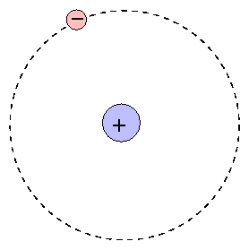
Hydrogen Atom
(x_{e},y_{e},z_{e})
Two particle central-force problem
Completely solvable – a rare example!
(x_{N},y_{N},z_{N})

Slide 3
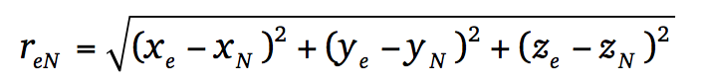
Hydrogen Atom
Schrödinger Equation

Slide 4
Hydrogen Atom: Relative Frame of Reference
Separation of Ĥ into Center of Mass and Internal co-ordinates
z
m_{e}(x_{e},y_{e},z_{e})
r_{e}
r_{eN}
-
CM
M_{N}
(x_{N},y_{N},z_{N})
R
r_{N}
y
x

Slide 5
Hydrogen Atom: Relative Frame of Reference
Checkout Appendix-1

Slide 6
Hydrogen Atom: Separation of CM motion
Free particle!
Kinetic energy of the atom
?

Slide 7
Hydrogen Atom: Electronic Hamiltonian

Slide 8
Hydrogen Atom: Electronic Hamiltonian
Not possible to separate out into three different co-ordinates. Need a new co-ordinate system

Slide 9
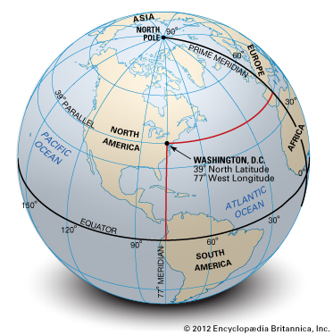
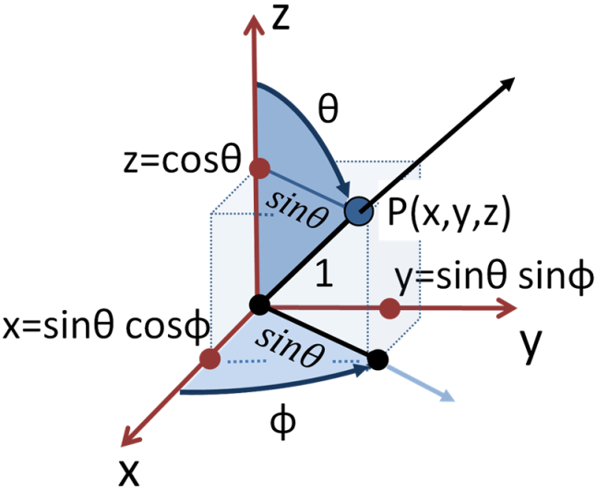
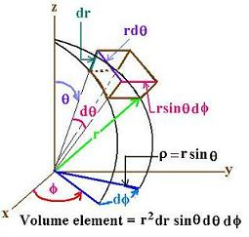
Spherical Polar Co-ordinates
r:0 to ∞
θ: 0 to π
φ: 0 to 2π

Slide 10
Laplacian in Spherical Coordinates

Slide 11
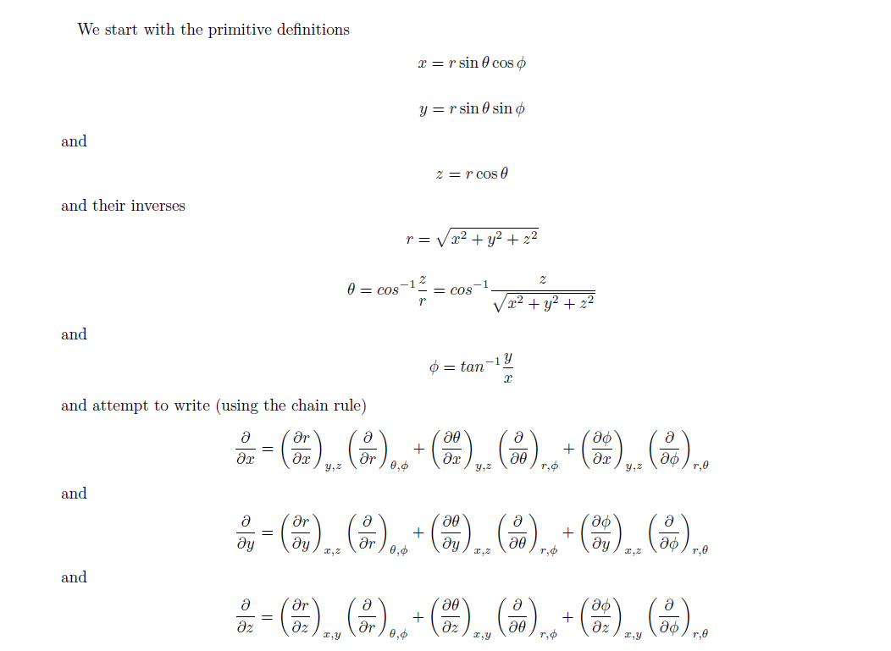
Laplacian in Spherical Coordinates
Appendix-2

Slide 12
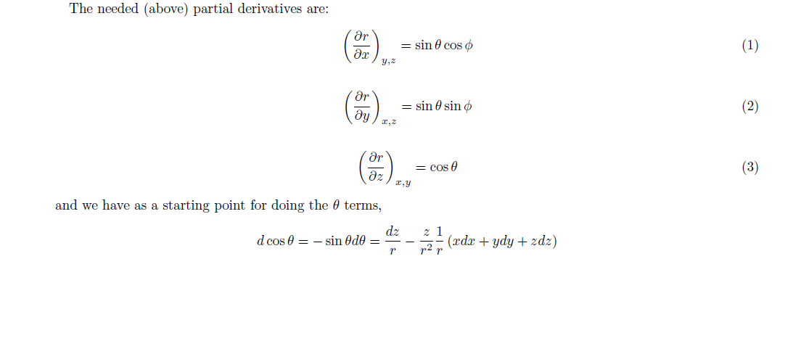
Laplacian in Spherical Coordinates
Appendix-2

Slide 13
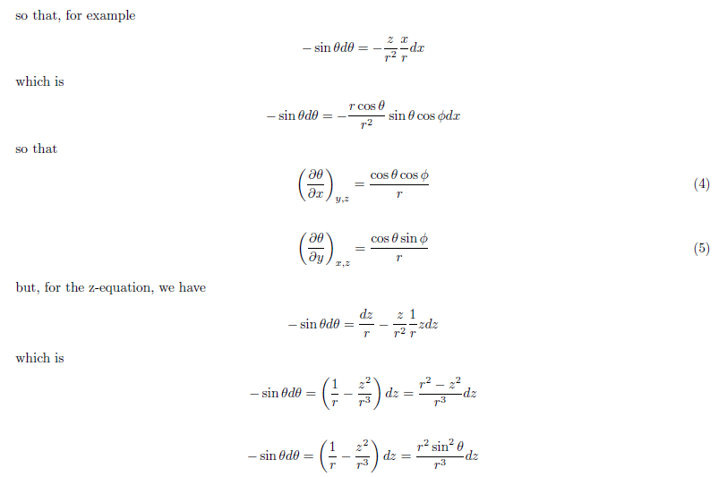
Laplacian in Spherical Coordinates
Appendix-2

Slide 14
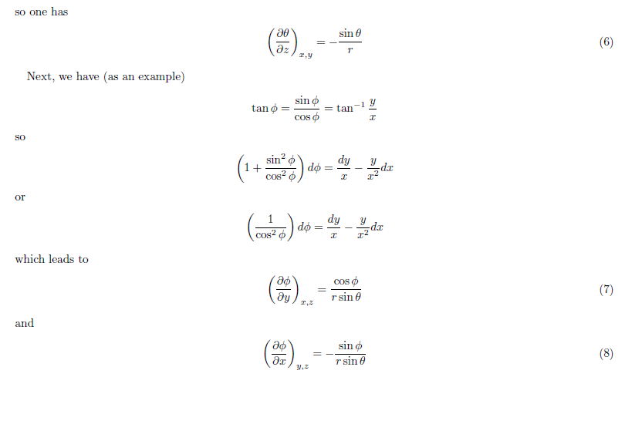
Laplacian in Spherical Coordinates
Appendix-2

Slide 15
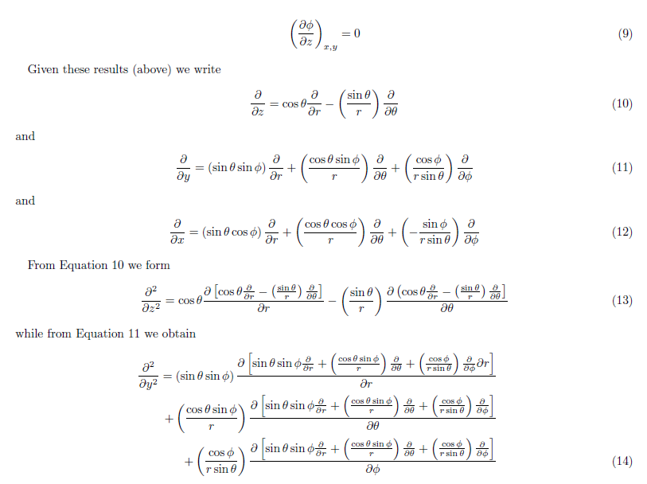
Laplacian in Spherical Coordinates
Appendix-2

Slide 16
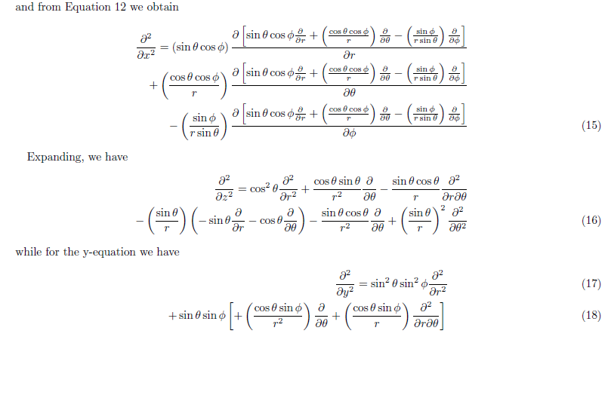
Laplacian in Spherical Coordinates
Appendix-2

Slide 17
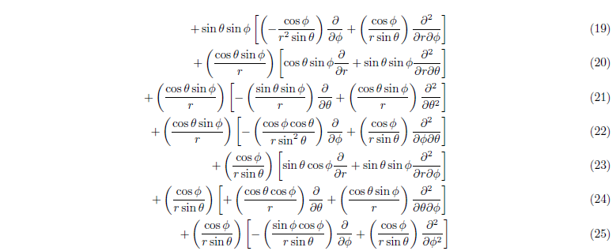
Laplacian in Spherical Coordinates
Appendix-2

Slide 18
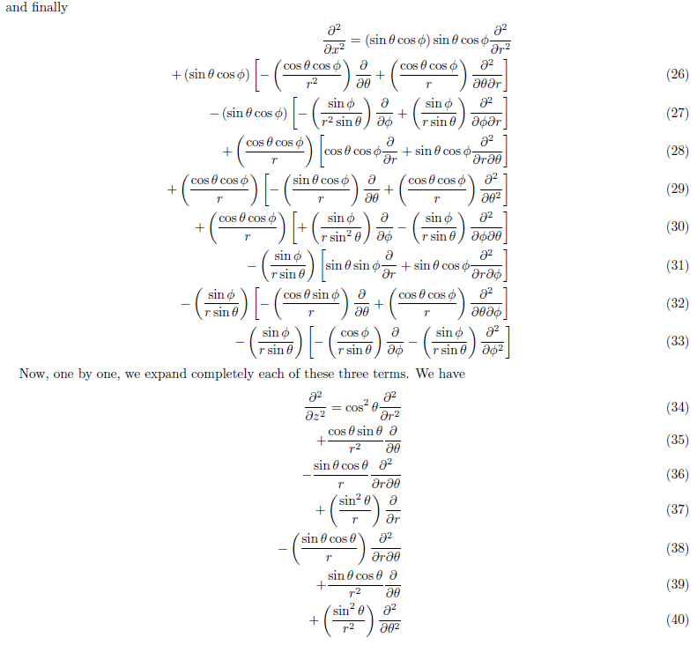
Laplacian in Spherical Coordinates
Appendix-2

Slide 19
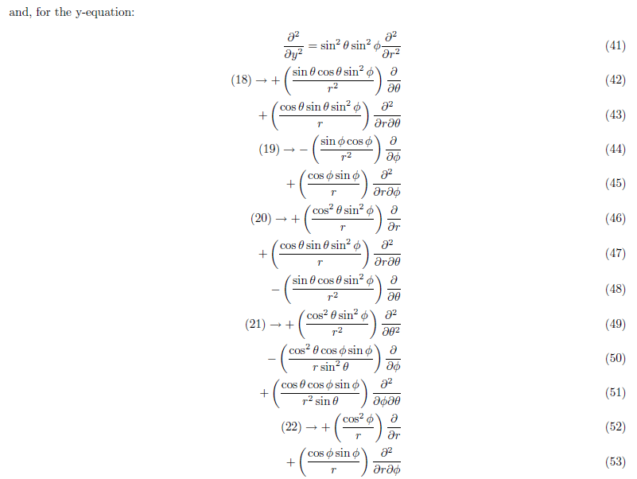
Laplacian in Spherical Coordinates
Appendix-2

Slide 20
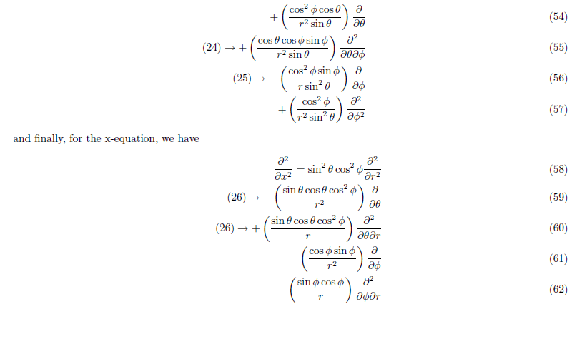
Laplacian in Spherical Coordinates
Appendix-2

Slide 21
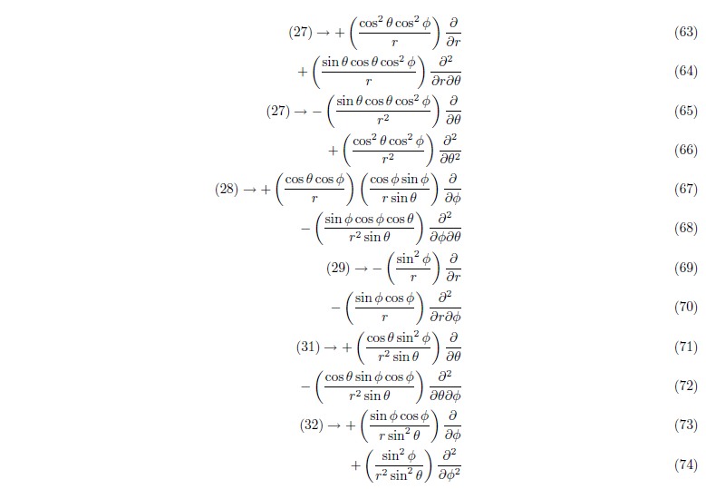
Laplacian in Spherical Coordinates
Appendix-2

Slide 22
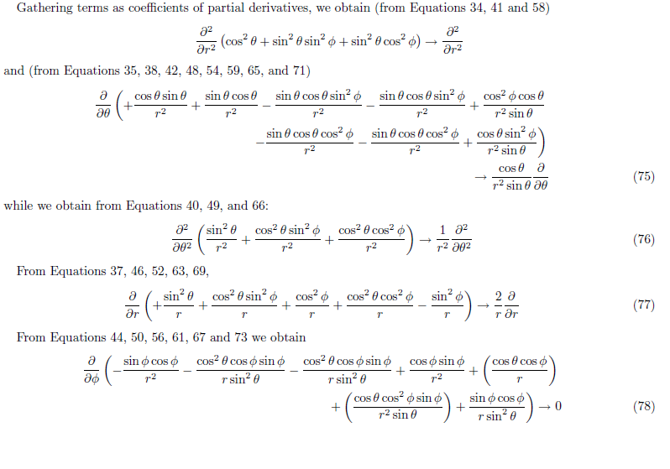
Laplacian in Spherical Coordinates
Appendix-2

Slide 23
Laplacian in Spherical Coordinates

Slide 24
Hamiltonian in Spherical Coordinates

Slide 25
Schrodinger equation for the electronic part in Spherical Polar Co-ordinates
and bring all the terms to the LHS

Slide 26
Separation of variables

Slide 27
Separation of variables
Upon differentiation

Slide 28
Separation of variables

Slide 29
Separation of variables
Radial
Angular
=β
A constant
Notes:
Till here in 4th lecture

Slide 30
Schrodinger Equation
Time-dependent Schrodinger equation

Slide 31
Schrodinger Equation
LHS is a function of co-ordinates and RHS is function of time. If these two have to be equal then both functions must be equal to constant, say W

Slide 32
Schrodinger Equation
Separation of variables
The solution of the differential equation

Slide 33
Separation of variables
Radial equation
Angular equation

Slide 34
Separation of variables
Radial equation
Angular equation

Slide 35
Separation of variables
The three variables r, θ and φ are separated

Slide 36
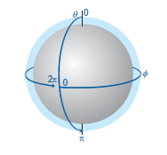
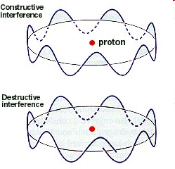
Solution to φ part
Trial solution:
Wavefunction has to be continuous
‘φ’ ranges from 0 to 2π
Periodic Boundary Condition

Slide 37
Solution to φ part
cos (2πm) + i sin (2πm) = 1
z
True only if m=0, ±1, ±2, ±3, ±4,….
What kind of information does Φ contain?
x
Change in φ: Circular motion in xy plane
z – component of angular momentum?
y

Slide 38
Angular momentum: from classical to quantum picture
Is Φ an eigenfunction?

Slide 39
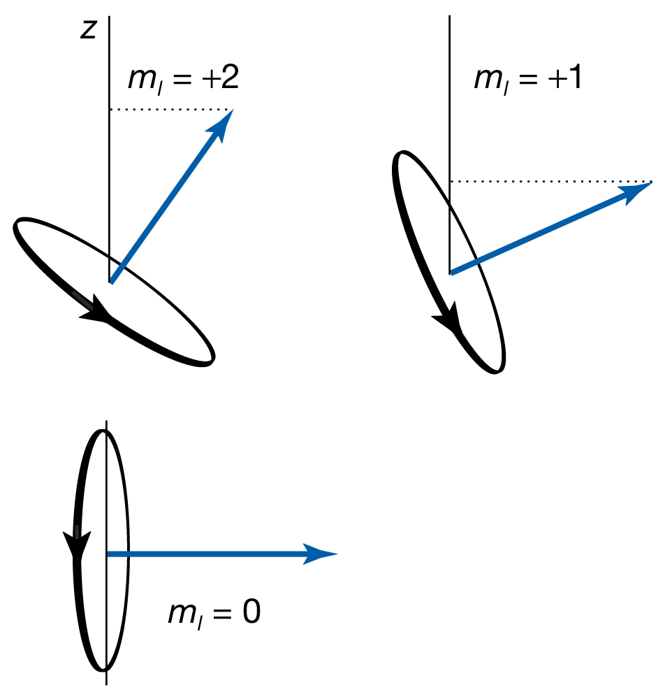
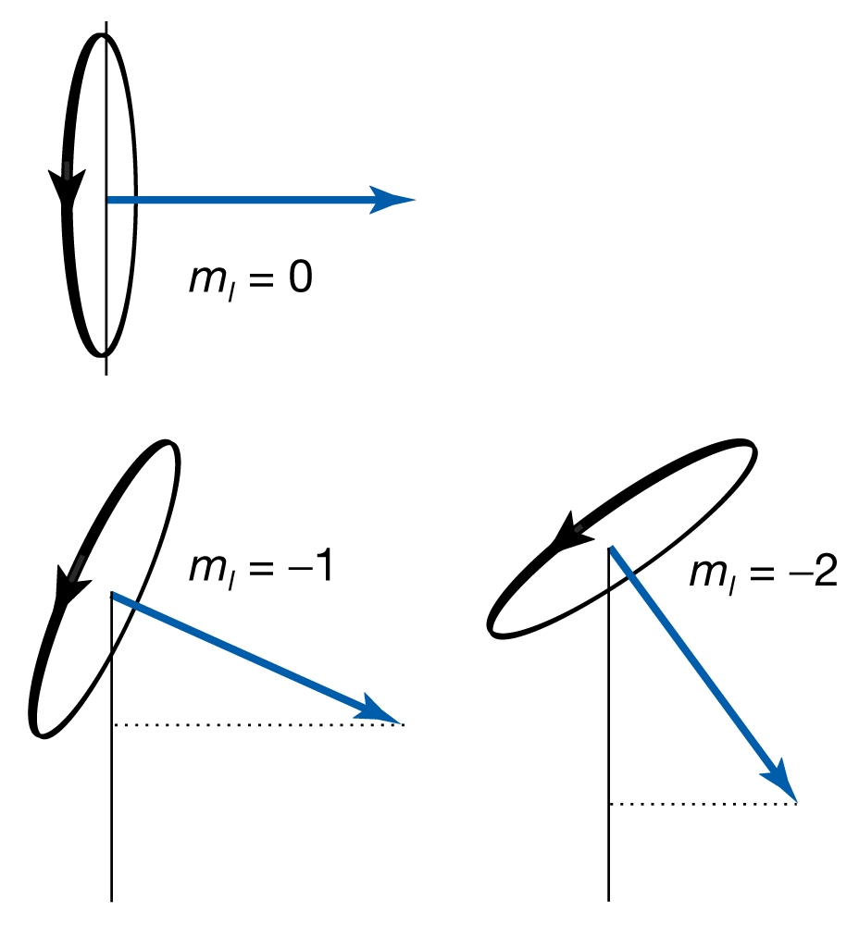
Moment of truth
z-component of angular momentum
m: Magnetic Quantum Number
“Space Quantization”

Slide 40
Solution to φ part
cos (2πm) + i sin (2πm) = 1
True only if m=0, ±1, ±2, ±3, ±4,….
m is the “magnetic quantum” number
m is restricted by another quantum number (orbital Angular momentum), l, such that |m|<l

Slide 41
The Θ and the R part
Solve to get R(r)
Solve to get Θ(θ)
Need serious mathematical skill to solve these two equations. We only look at solutions

Slide 42
The Θ part
Solution to Θ(θ) :
l=0,1,2,3…
:Associated Legendre Polynomials
New quantum number ‘l’ : orbital / Azimuthal quantum number
Restriction on m≤l
is due to this equation

Slide 43
The angular (Θ·Φ) part
The angular part of the solution
are called spherical harmonics
l=0,1,2,3…
m=0, ±1, ±2, ±3… and |m|≤l

Slide 44
The R part
Solution to R(r) are
Restriction on l<n
Where are called associated Laguerre functions
The new quantum number is ‘n’ called principal quantum number

Slide 45
Energy of the Hydrogen Atom
Energy is dependent only on ‘n’
Energy obtained by full quantum mechanical treatment is equal to Bohr energy
Potential energy term is only dependent on the Radial part and has no contribution from the Angular parts

Slide 46
Quantum Numbers of Hydrogen Atom
n Principal Quantum number
Specifies the energy of the electron
l Orbital Angular Momentum Quantum number
Specifies the magnitude of the electron's orbital angular momentum
m Z-component of Angular Momentum Quantum number
Specifies the orientation of the electron's orbital angular momentum
s Orbital Angular Momentum Quantum number
Specifies the orientation of the electron's spin angular momentum

